Slide 1

UXJourney
the
The process to optimize your resource for the quality User Requirement
W R I T T E N B Y H C I G R O U P

Slide 2
UXJourney
the
The process to optimize your resource for the Requirement quality User
Second Versions
Written by HCI Group
Universitas Muhammadiyah Malang and Universiti putra malaysia
Wahyu Andhyka Kusuma Azrul Hazri bin Jantan Novia Admodisastro Noris Mohd Norowi

Slide 3
UXJourney
the
The process to optimize your resource for the quality User Requirement
The UX journey is a process that helps optimize resources for quality user requirements while improving self-efficacy. The process involves a series of steps that begin with understanding the user's needs and expectations. This includes research to gain insights into the user's goals, motivations, and pain points. Once the user's needs have been identified, the next step is to develop a user persona, which is a detailed description of the user's characteristics, preferences, and behaviors. This persona serves as a reference point throughout the UX design process.
The next step in the UX journey is to define the user journey, which is the user's path to achieving their goals. This includes mapping out the steps involved in the user's interactions with the product or service and identifying potential pain points or areas for improvement.
Once the user journey has been defined, the UX designer can prototype and test different solutions. This involves creating wireframes, mockups, and prototypes of the product or service and testing these designs with users to gather feedback and identify areas for improvement.
Throughout the UX journey, it is important to focus on the user’s needs and expectations and continuously iterate and improve the design based on feedback and testing. By following this process, designers can optimize their resources to deliver quality user requirements while building their self-efficacy and confidence in their design decisions.

Slide 4
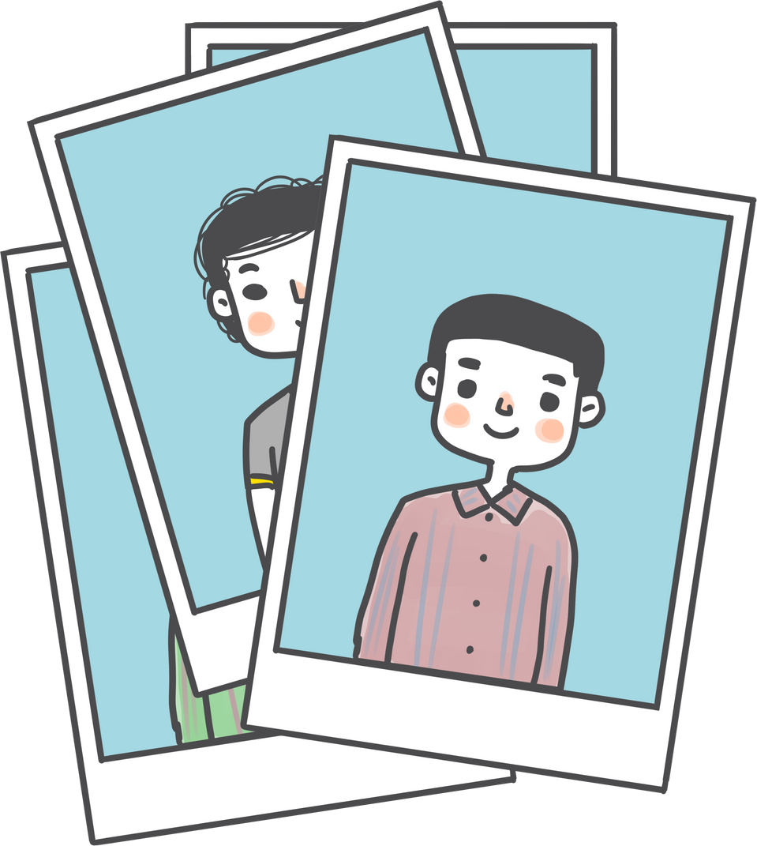
Hello
This is my UX Diary
PLACE YOUR
PHOTO
HERE
Tell me about your personality and ability

Slide 5
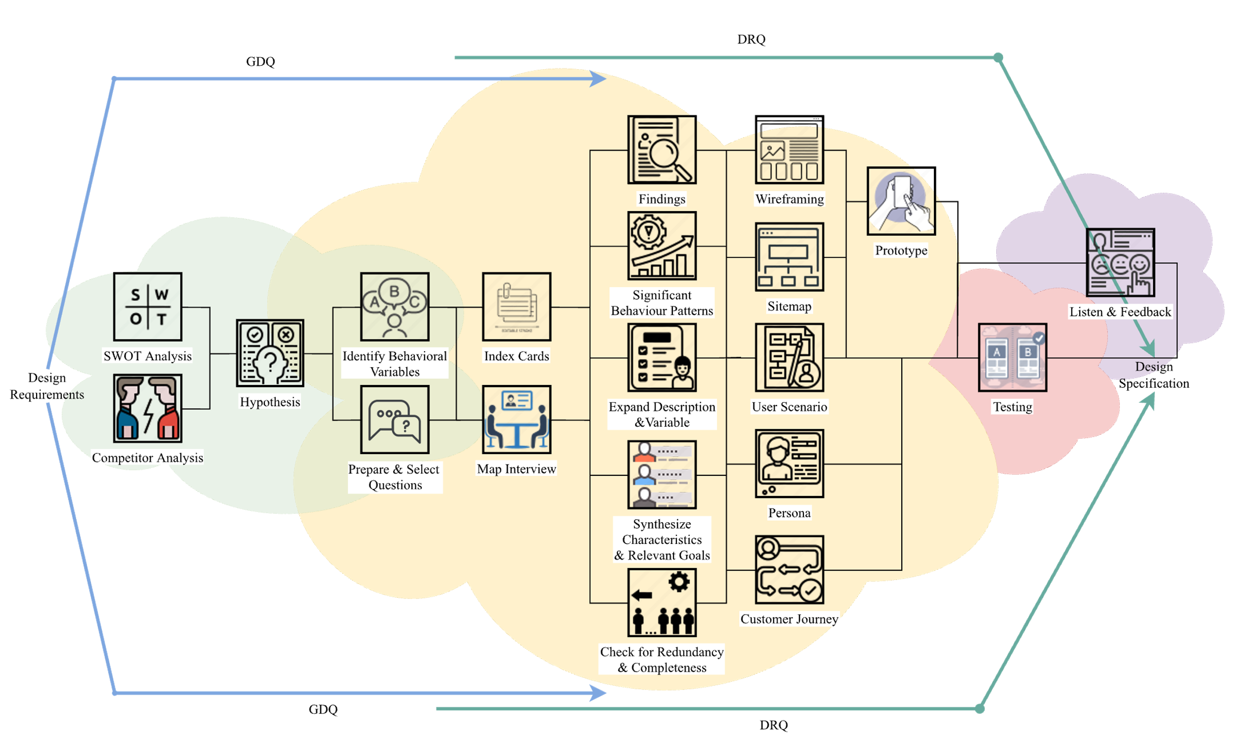
UXJourney
the
The process to optimize your resource for the quality User Requirement

Slide 6
UX Journey Activities Checklist
Activity | Time* | Activity | Time*
(D) Discover |  | Expand the Description of Attributes and Behavior
Field studies |  | Persona
SWOT Analysis |  | Journey Mapping
Competitor Analysis |  | User Scenario and Stories
State hypotheses |  | Sitemap
Identify Behavioral Variables |  | Wireframing
(E) Explore |  | (T) Test
Prepare Questions |  | Quantitative & Qualitative Usability Testing
Meet Stakeholder |  | A/B Testing
Index Card |  | Objective Verification
Map Interview Subjects to Behavioral Variables |  | Variable Verification
Identify Significant Behavior Patterns |  | Acceptance Criteria
Synthesize Characteristics and Relevant Goals |  | (L) Listen
Check for Redundancy and Completeness |  | Follow up
*Time in minutes

Slide 7
My Goals
Kickstart Project | Day 1 | Day 2 | Day 3
Time allocation
Day 4 | Day 5 | Day 6 | Day 7
Day 8 | Day 9 | Day 10 | Day 11
Day 12 | Day 13 | Day 14 | Deliver Project

Slide 8



Slide 9
Field studies

Slide 10
SWOT analysis
Strength
Advantages?
Uniqueness?
Selling Points?
Skills?
Other factors?
Weaknesses
Limitations?
Lack of effort?
Problems?
Poor strategy?
Other factors?
Opportunities
Improvements?
Performance?
Opportunities?
Consumer behavior?
Other factors?
Threats
External trouble?
obstacles?
Trends?
Other factors?

Slide 11
Competitor
DIRECT COMPETITION
INDIRECT COMPETITION
USER REVIEWS

Slide 12
Hypotheses
HYPOTHESES PERSONAS
EXPLANATION

Slide 13
Hypotheses Explanation

Slide 14
Identify Behavioral Variables
OBSERVED BEHAVIORAL VARIABLE
SCALE

Slide 15
Variable Explanation

Slide 16


Slide 17
1 5-minute prepare questions
2 Minutes | Welcome Remarks
2 Minutes | Collect demographics
2 Minutes | Tell a story
2 Minutes | Problem ranking
3 Minutes | Explore customer's word view
2 Minutes | Wrapping up
2 Minutes | Document results

Slide 18
Prepared questions

Slide 19
Creativity is intelligence having fun
Albert Einstein

Slide 20
Meet stakeholder
OBJECTIVE AND EXPECTED RESULTS
5 MINUTES QUESTIONS

Slide 21
Findings
MENTION YOUR FINDINGS
MENTION YOUR FINDINGS
MENTION YOUR FINDINGS
MENTION YOUR FINDINGS

Slide 22





Persona name:
As [a user persona], I want [to perform this action] so that [I can accomplish this goal].
As [a user persona], I want [to perform this action] so that [I can accomplish this goal].
As [a user persona], I want [to perform this action] so that [I can accomplish this goal].
As [a user persona], I want [to perform this action] so that [I can accomplish this goal].
As [a user persona], I want [to perform this action] so that [I can accomplish this goal].
As [a user persona], I want [to perform this action] so that [I can accomplish this goal].
As [a user persona], I want [to perform this action] so that [I can accomplish this goal].
As [a user persona], I want [to perform this action] so that [I can accomplish this goal].
Share your idea, write in this notes

Slide 23
Persona name:
As [a user persona], I want [to perform this action] so that [I can accomplish this goal].
As [a user persona], I want [to perform this action] so that [I can accomplish this goal].
As [a user persona], I want [to perform this action] so that [I can accomplish this goal].
As [a user persona], I want [to perform this action] so that [I can accomplish this goal].
As [a user persona], I want [to perform this action] so that [I can accomplish this goal].
As [a user persona], I want [to perform this action] so that [I can accomplish this goal].
As [a user persona], I want [to perform this action] so that [I can accomplish this goal].
As [a user persona], I want [to perform this action] so that [I can accomplish this goal].
Share your idea, write in this notes

Slide 24
Persona name:
As [a user persona], I want [to perform this action] so that [I can accomplish this goal].
As [a user persona], I want [to perform this action] so that [I can accomplish this goal].
As [a user persona], I want [to perform this action] so that [I can accomplish this goal].
As [a user persona], I want [to perform this action] so that [I can accomplish this goal].
As [a user persona], I want [to perform this action] so that [I can accomplish this goal].
As [a user persona], I want [to perform this action] so that [I can accomplish this goal].
As [a user persona], I want [to perform this action] so that [I can accomplish this goal].
As [a user persona], I want [to perform this action] so that [I can accomplish this goal].
Share your idea, write in this notes

Slide 25
Persona name:
As [a user persona], I want [to perform this action] so that [I can accomplish this goal].
As [a user persona], I want [to perform this action] so that [I can accomplish this goal].
As [a user persona], I want [to perform this action] so that [I can accomplish this goal].
As [a user persona], I want [to perform this action] so that [I can accomplish this goal].
As [a user persona], I want [to perform this action] so that [I can accomplish this goal].
As [a user persona], I want [to perform this action] so that [I can accomplish this goal].
As [a user persona], I want [to perform this action] so that [I can accomplish this goal].
As [a user persona], I want [to perform this action] so that [I can accomplish this goal].
Share your idea, write in this notes

Slide 26
If a User is having a problem, it's our problem.
Steve Jobs

Slide 27

Map Interview
USER FEELING
Persona:
Variable:
Scale 1: | Scale 2: | Scale 3: | Scale 4: | Scale 5:
Respondent: 1. 2. | Respondent: 1. 2. | Respondent: 1. 2. | Respondent: 1. 2. | Respondent: 1. 2.
Variable:
Scale 1: | Scale 2: | Scale 3: | Scale 4: | Scale 5:
Respondent: 1. 2. | Respondent: 1. 2. | Respondent: 1. 2. | Respondent: 1. 2. | Respondent: 1. 2.

Slide 28
Map Interview
USER FEELING
Persona:
Variable:
Scale 1: | Scale 2: | Scale 3: | Scale 4: | Scale 5:
Respondent: 1. 2. | Respondent: 1. 2. | Respondent: 1. 2. | Respondent: 1. 2. | Respondent: 1. 2.
Variable:
Scale 1: | Scale 2: | Scale 3: | Scale 4: | Scale 5:
Respondent: 1. 2. | Respondent: 1. 2. | Respondent: 1. 2. | Respondent: 1. 2. | Respondent: 1. 2.

Slide 29
Significant Behaviour Patterns
OBSERVED BEHAVIORAL VARIABLE
SCALE
PERCENTAGE

Slide 30
Pattern Explanation

Slide 31





Synthesize Characteristics And Relevant Goals
PATTERN
Persona:
Variable:
 | ___% | ___% | ___% | ___% | ___%
Variable:
 | ___% | ___% | ___% | ___% | ___%
Variable:
 | ___% | ___% | ___% | ___% | ___%
Variable:
 | ___% | ___% | ___% | ___% | ___%
Variable:
 | ___% | ___% | ___% | ___% | ___%

Slide 32
Synthesize Explanation

Slide 33
Want your
users to fall in
love with your
designs? Fall in
love with your users.
Dana Chisnell

Slide 34
Check for Redundancy and Completeness
Is there anything missing from the personas mappings, characteristics and objectives that needs to be added?
If so, please specify:
To satisfy stakeholder assumptions or requests, does any other persona need to be added?
If so, please specify which persona should be added:
Are they any two personas that differ only as to social-demographic variables?
If so, please specify what decision is to be taken:
Remove one of the personas. If so, specify which one:
Examine characteristics more thoroughly and differentiate personas.:
Are all created personas significantly different?
If so, please state which personas are alike:
Overall, are the created personas representative enough of the diversity of real-world behavior and needs?

Slide 35
Expand Description and Variable
TODAY I AM FEELING...
TODAY I AM GOTING TO...
TODAY I AM LOOKING FORWARD TO...
MY AFFIRMATION TODAY

Slide 36
Persona
Persona name:
Roles & tasks:
Age:
Profession:
User quote:
Personality traits/ behaviour:
Lifestyle:
Motivation:
Skill & Knowledge:
Novice (browsing, email)
Intermediate (social media)
Proficient (manage website)
Expert (programing complex web)
Authority (publish influential research)
Other Skill & Knowledge:
Segment:
Sketch persona:

Slide 37
To create a memorable design, you need to start with a thought that’s worth
remembering.
Thomas Manss

Slide 38




Customer Journey Mapping
1
Decide on a target customer persona and the scope of the journey to be explored today.
Give them a visual representation, name and description.
2
Use sticky notes to build a back story, including the customer's reasons for taking this particular journey.
3
Ideally, 1 persona = 1 journey map. Duplicate these pages to repeat the exercise for another persona.
Key Attribute
Short Description
Add your thought here
Add your thought here
Persona 1 [Insert persona's name here]
Needs
Challenges
Add your thought here
Add your thought here
Opportunities
Add your thought here

Slide 39




Persona 1
4
Describe the persona's journey in the first 3 rows, using one sticky note per action. "User actions" pertain to activities; "touchpoints" are interaction points like a website or email; and "pain points" refer to frustrations, errors and bottlenecks.
5
In the "emotions" row, move the dots up or down the colored spectrum to visually show how the persona's emotional experience rises and falls throughout the journey. Positive peaks = delight, while sudden drops = frustration.
6
In the final row, brainstorm possible solutions or areas of opportunity to improve the persona's experience.
Awareness
Consideration
Purchase
Onboarding
Advocacy
User Actions
Add your thought here
Add your thought here
Add your thought here
Add your thought here
Add your thought here
Touchpoints
Pain points
D e l i g h t e d
Emotions
F r u s t r a t e d
Possible Solutions

Slide 40
Usability rules the Web. If customers can't find a product, they will not buy it.
Jakob Nielsen

Slide 41
User Scenario and Stories

Slide 42
Sitemap
Home

Slide 43
Wireframing
Screen name:
Component:
Heuristic violated:

Slide 44

Wireframing

Slide 45


Slide 46
Qual & Quant
QUALITATIVE RESEARCH
QUANTITATIVE RESEARCH
Focus on "why"
Focus on "how many" & "how much"
Inform design decisions
Evaluate the usability of an existing site
Identify usability issuesand find solutions
Track usability over time
Findings based on the researcher’s impressions, interpretations, and prior knowledge
Compare site with competitors
USER REVIEWS

Slide 47
AB Testing
Variable:
 | ___% | ___% | ___% | ___% | ___%
Variable:
 | ___% | ___% | ___% | ___% | ___%
Note:
Note:

Slide 48
Verification
PERSONAS
EXPLANATION
HYPOTHESES

Slide 49
Objective Explanation

Slide 50
Objective Behavioral Variables
OBSERVED BEHAVIORAL VARIABLE
SCALE

Slide 51
Acceptance Criteria
Positive Case
Given | When | Then | User Interface

Slide 52
Acceptance Criteria
Negative Case
Given | When | Then | User Interface

Slide 53


Slide 54
Follow up

Slide 55

UXJourney
the
The process to optimize your resource for the quality User Requirement
From Developer for Developer

